Slide 1
Financial Modeling
The Meteoric Rise of Tesla (TSLA)
Dhruv Srikanth

Slide 2
Table of Contents
Objectives
Motivation
Datasets
Software
Approach
Feature Engineering
Feature Engineering - Visualized
Model Architecture
Model Training
Model Evaluation - Quantitative
Model Evaluation - Qualitative
Challenges
Takeaways
References

Slide 3
Objectives
Model the rise in stock price of Tesla between 2010 and 2020
Augment data through feature engineering to create a feature rich dataset
Forecast Tesla’s stock price

Slide 4
Motivation
To investigate Tesla as a sentiment driven stock
Gain deeper insight on indicators that reflect a stock’s value
To potentially augment automated trading bots with sentiment analysis

Slide 5
Datasets
Stock Price Kaggle Dataset - https://www.kaggle.com/timoboz/tesla-stock-data-from-2010-to-2020
This contains Tesla’s stock price over 10 years from 2010 to 2020 (by day)
The dataset will be augmented with sentiment information on Elon Musk’s tweets
Elon Musk Tweet Kaggle Dataset - https://www.kaggle.com/ayhmrba/elon-musk-tweets-2010-2021

Slide 6
Software
Language - python
Environment - google colab, jupyter notebook
Modules -
Model Creation - tensorflow
Utility - sklearn, pandas, numpy, tweet-preprocessor
Visualization - matplotlib, seaborn
Sentiment Analysis - vaderSentiment

Slide 7
Approach
Feature engineering
Model choice, training and evaluation

Slide 8
Feature Engineering
Produce feature rich dataset
Include financial indicators such as RSI, MACD, momentum for short, long and medium time trends
Augment dataset with non-traditional indicators such as sentiment

Slide 9
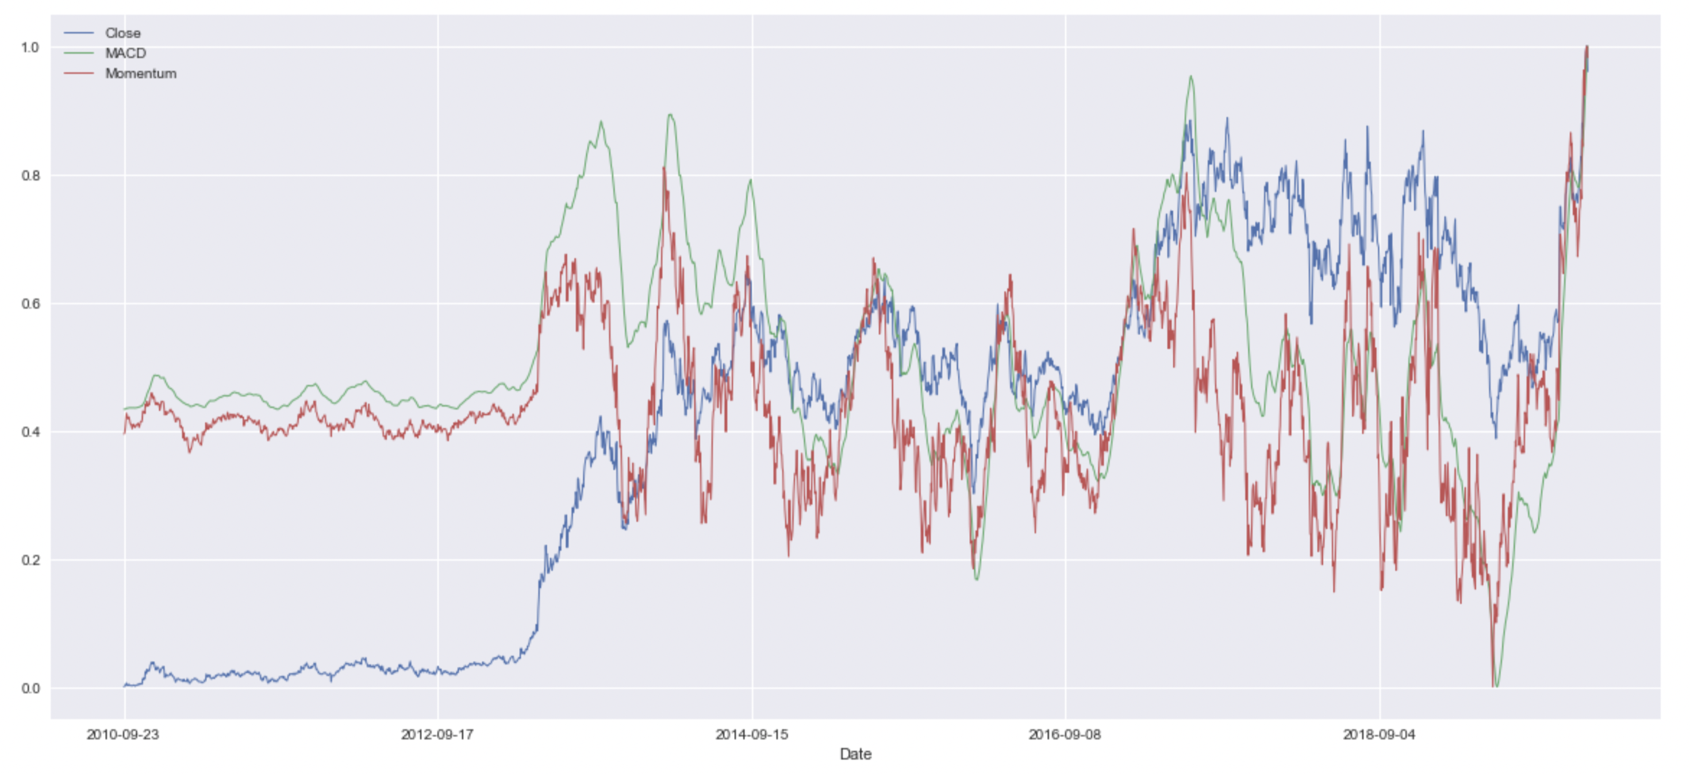
Feature Engineering - Visualized

Slide 10
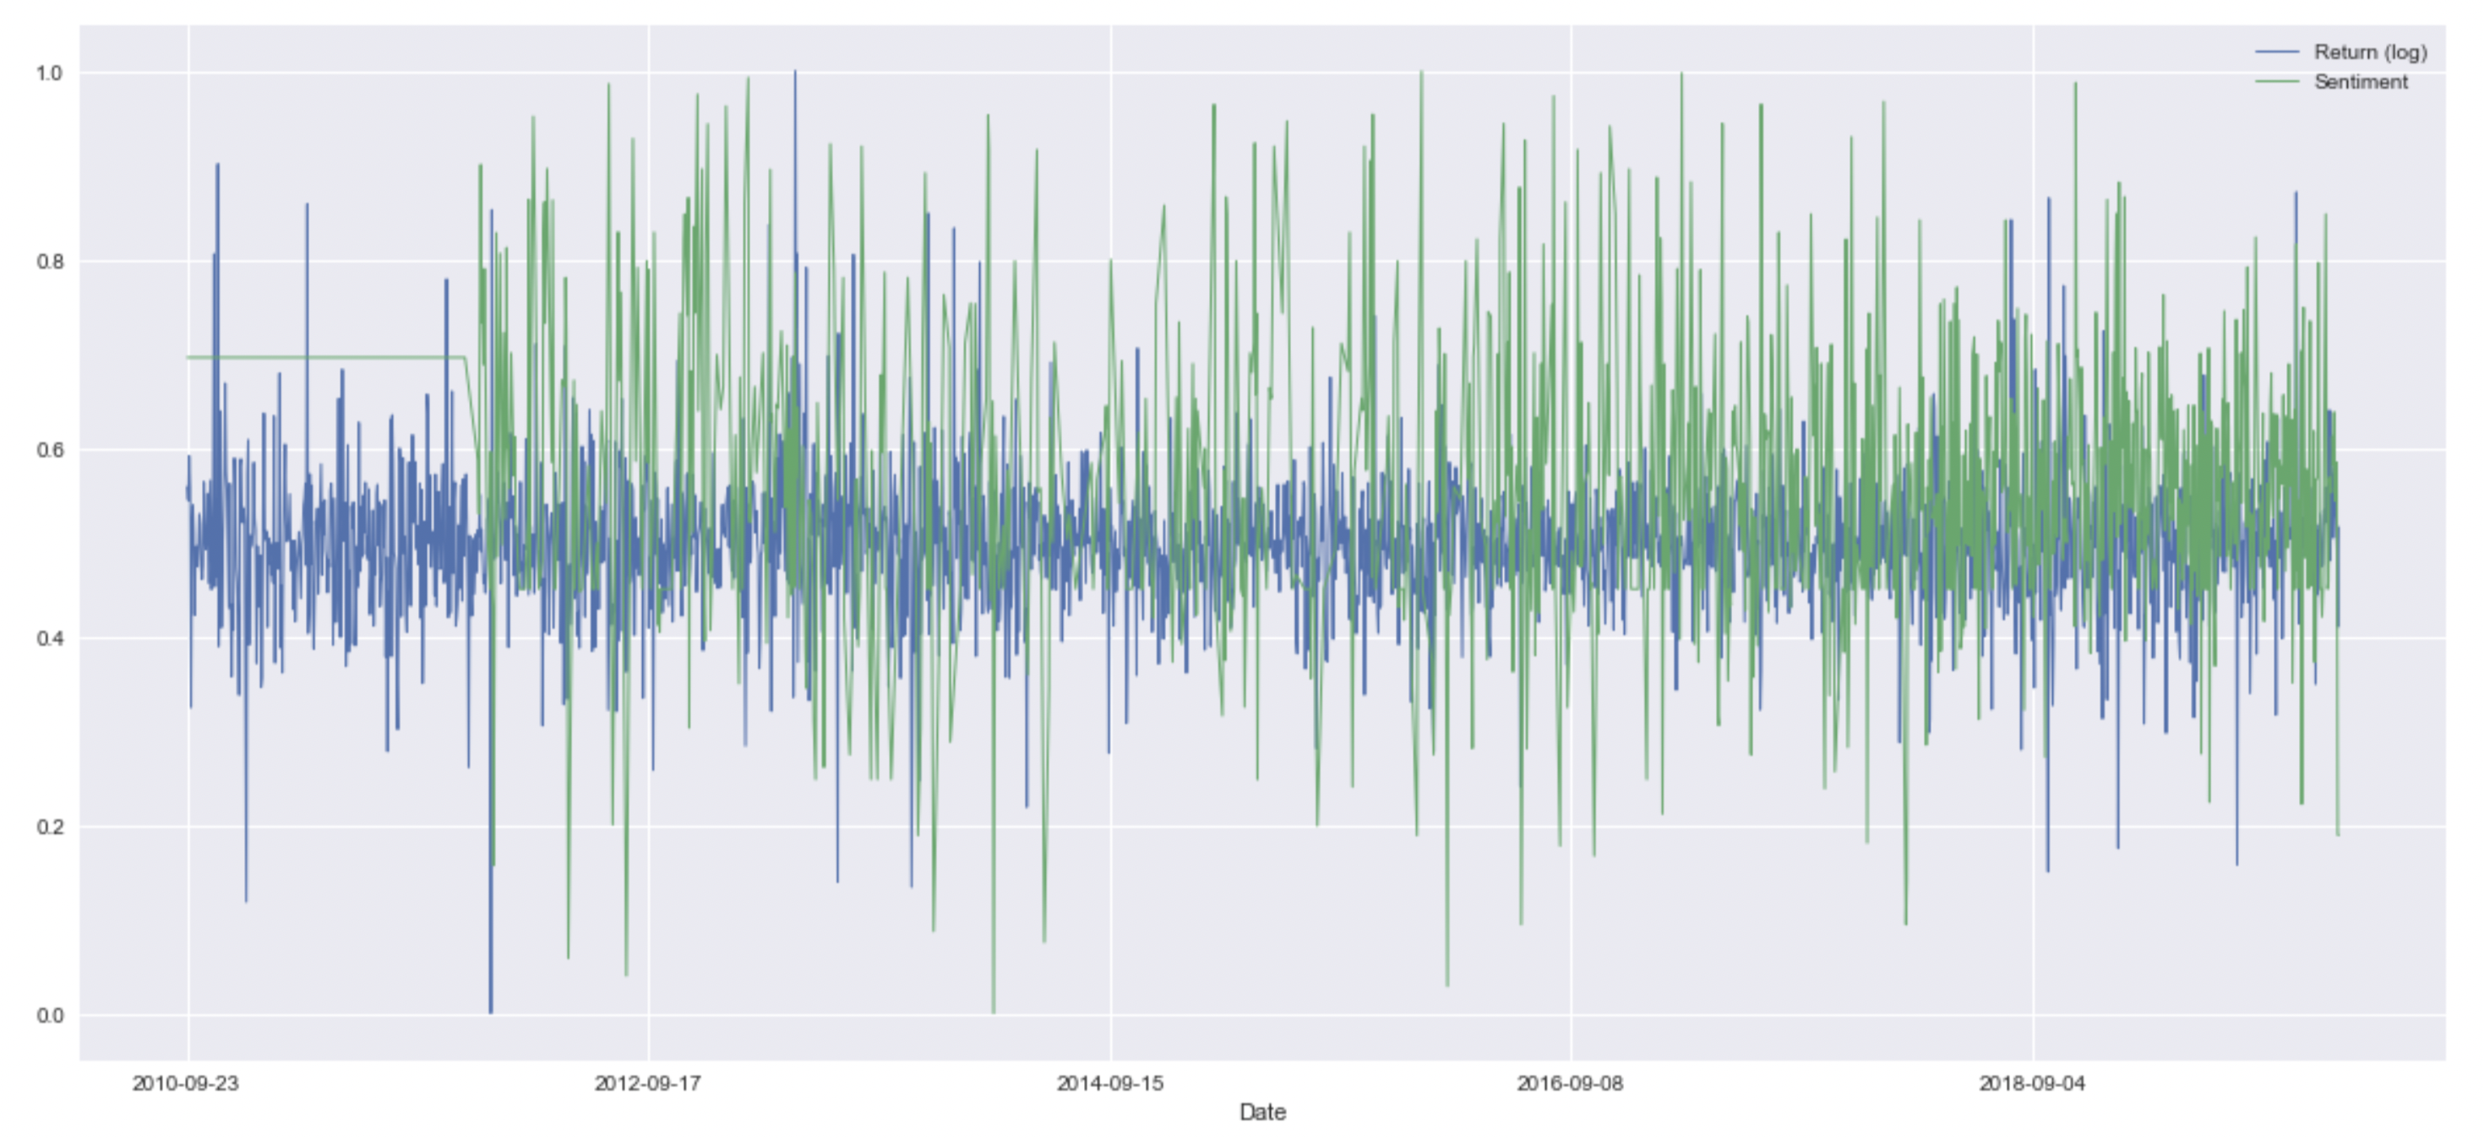
Feature Engineering - Visualized

Slide 11
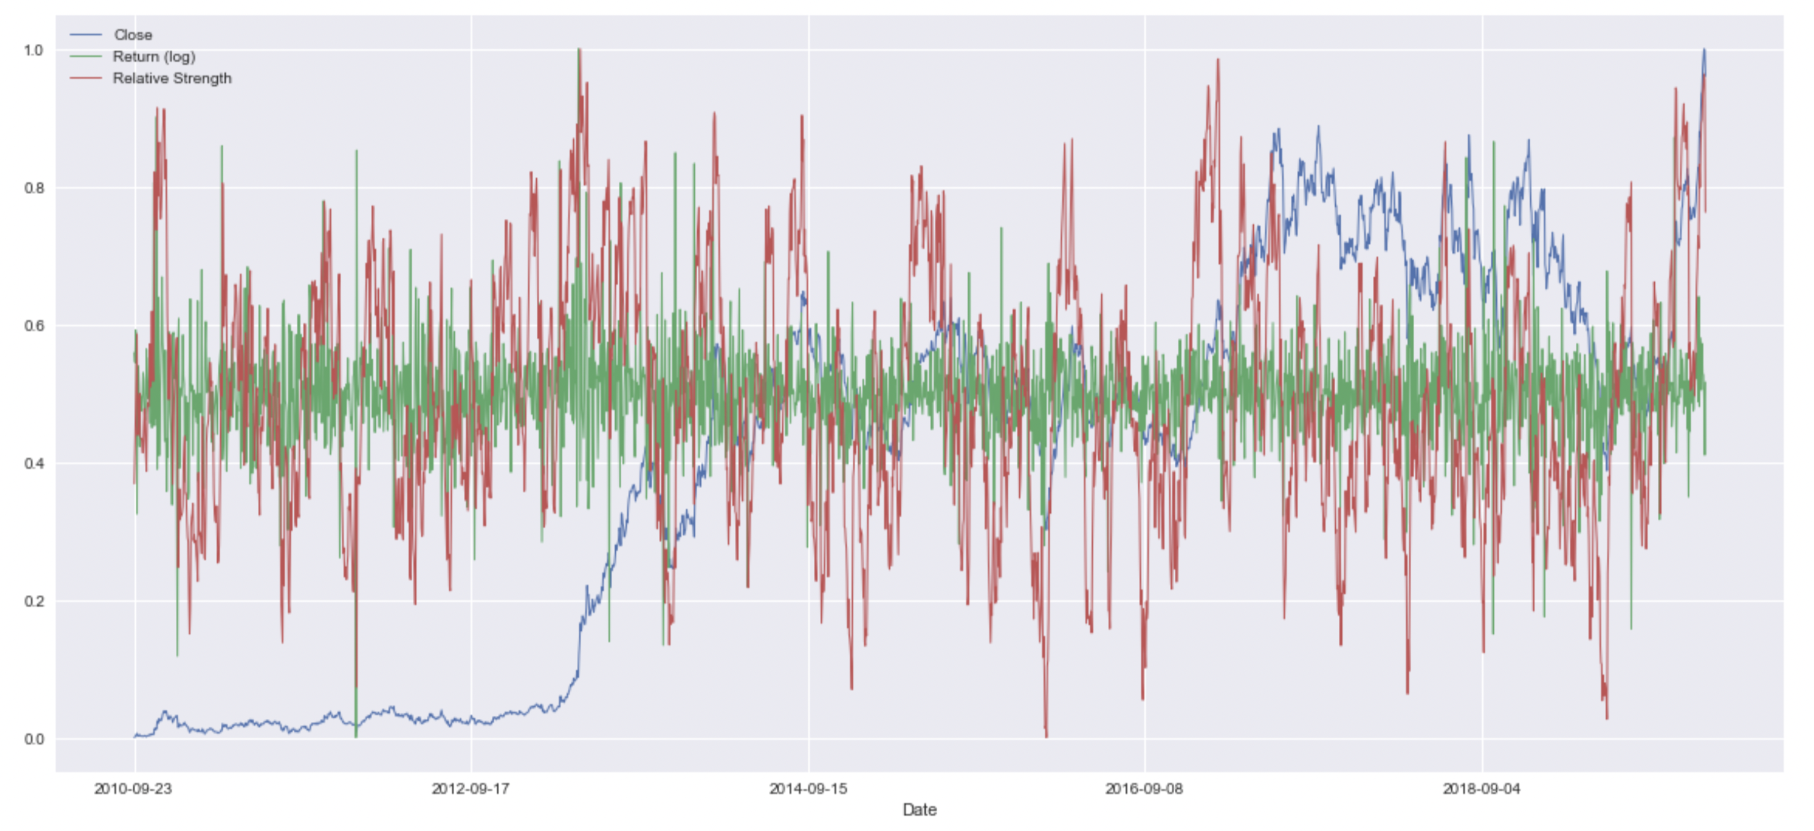
Feature Engineering - Visualized

Slide 12
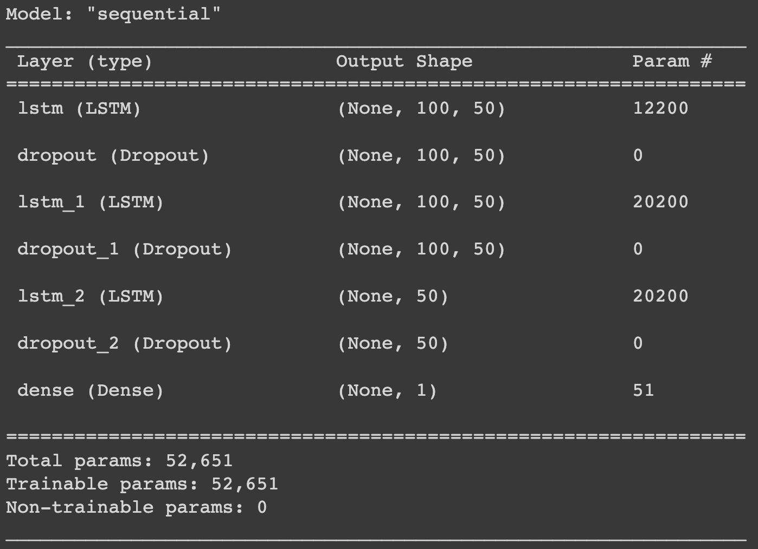
Model Architecture

Slide 13
Model Training
Train-Test split - 70%-30%
Validation split on the training data is 35%
Sliding window over data - 100 days
Epochs trained for - 20
Batch size - 32
Environment - Google Colab
Optimizer - Adam
Loss and Metric - Root mean squared error (RMSE)

Slide 14
Model Evaluation - Quantitative
Model achieved an RMSE of 0.0651 on the test set
Lower than papers referenced
Potential cause is referenced papers model multiple stocks with the same model

Slide 15
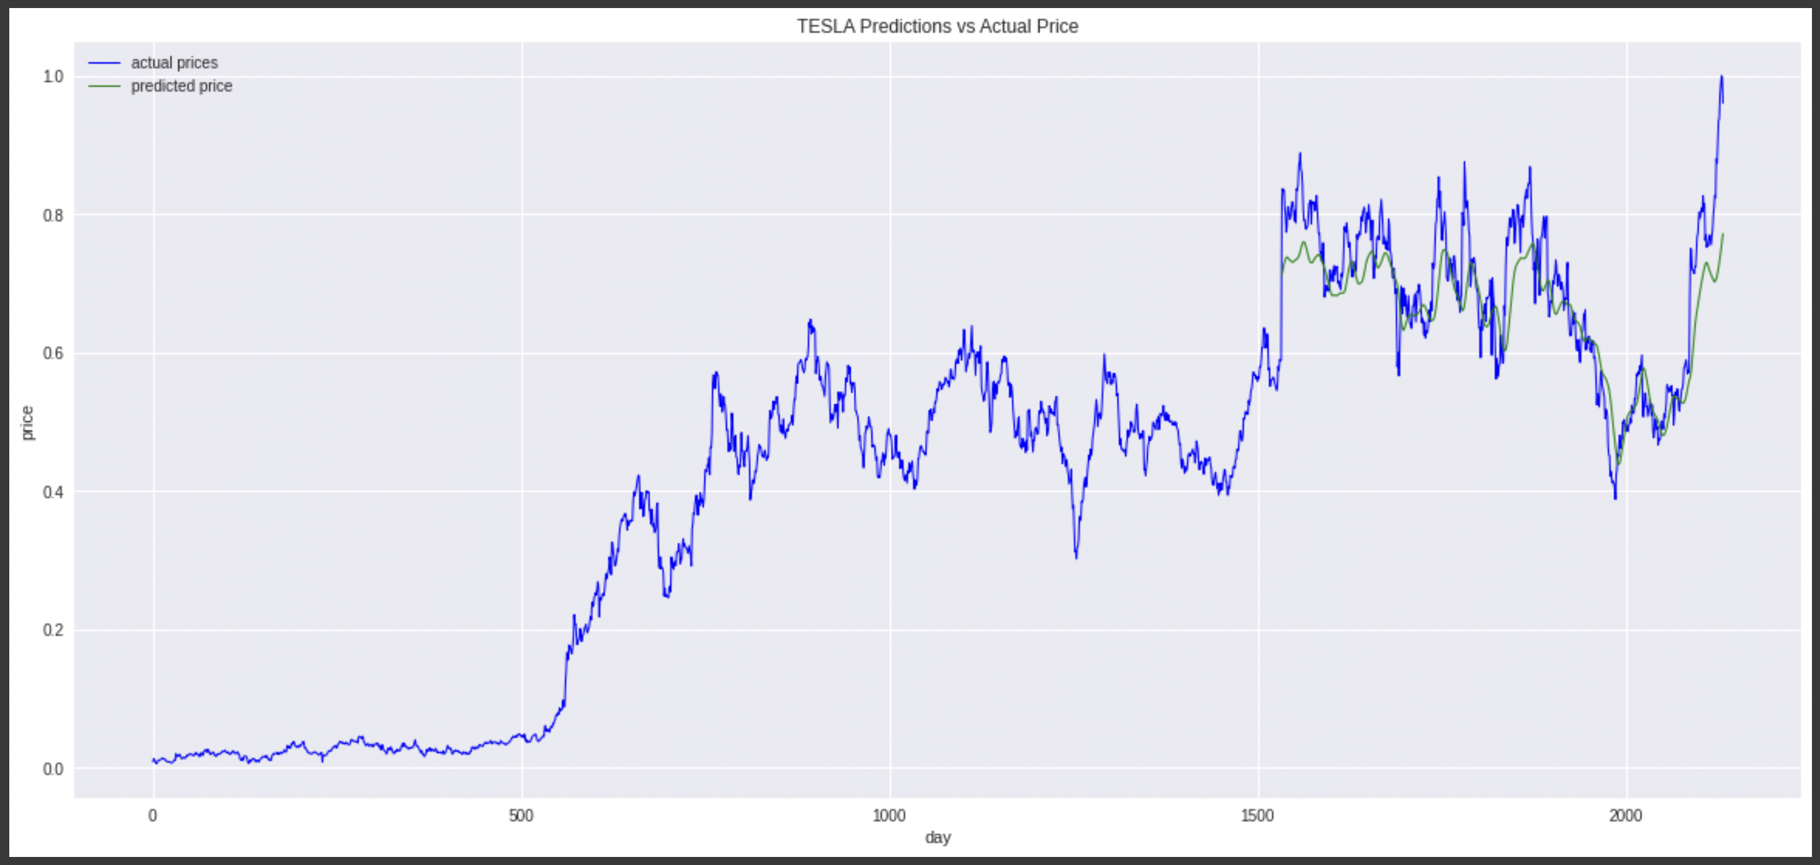
Model Evaluation - Qualitative

Slide 16
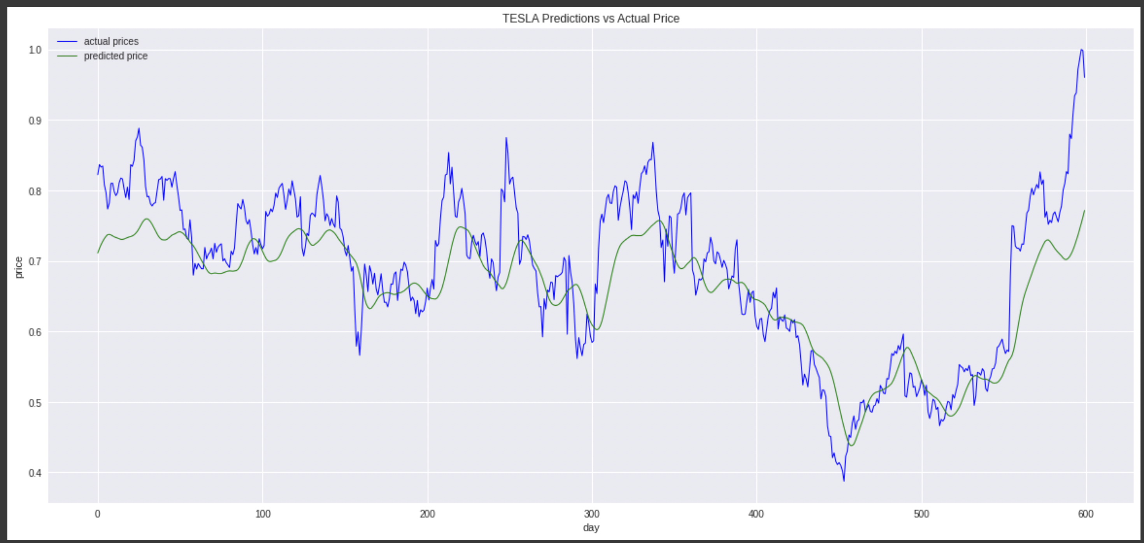
Model Evaluation - Qualitative (Magnified)

Slide 17
Challenges
Tradeoffs between different architectures - ESNs, GRUs, LSTMs, RNNs
Understanding widely used financial indicators - RSI, MACD

Slide 18
Takeaways
The effectiveness of LSTMs in time series forecasting
Noting tradeoffs between similar architectures such as GRUs and LSTMs and their potential use based on the application of the model
Significance of feature engineering
Use of non-traditional information such as sentiment to augment the dataset

Slide 19
References
Tesla Stock Dataset - https://www.kaggle.com/timoboz/tesla-stock-data-from-2010-to-2020
Elon Musk Tweets Dataset - https://www.kaggle.com/ayhmrba/elon-musk-tweets-2010-2021
Stock Prediction using Sentiment analysis and Long Short Term Memory - https://ejmcm.com/ pdf_3126_16b444b632c88db6fed0c6558dd6930a.html
Harvesting social media sentiment analysis to enhance stock market prediction using deep learning - https://www.ncbi.nlm.nih.gov/pmc/articles/PMC8053016/

Slide 20
References
Echo State Networks - https://towardsdatascience.com/gentle-introduction-to-echo-state- networks- af99e5373c68#:~:text=Echo%20state%20network%20is%20a,randomly%20assigned%20and% 20not%20trainable
Gated Recurrent Units - https://towardsdatascience.com/understanding-gru- networks-2ef37df6c9be

